Slide 1

Natural Disasters
Iron Hack Final Project
Oct - 2023
Jéssica Castelo

Slide 2
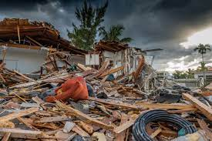
Natural Disasters - Dataset
In 1988, the Centre for Research on the Epidemiology of Disasters (CRED) launched the Emergency Events Database (EM-DAT).
EM-DAT was created with the initial support of the World Health Organisation (WHO) and the Belgian Government.
The dataset is from 1900 – 2021.

Slide 3
Natural Disasters
Disasters: “situations or events which overwhelm local capacity, necessitating a request for external assistance at the national or international level. Disasters are unforeseen and often sudden events that cause significant damage, destruction, and human suffering.” - EM-DAT
EM-DAT focuses on major disasters
10 fatalities
100 affected people
a declaration of state of emergency
a call for international assistance

Slide 4
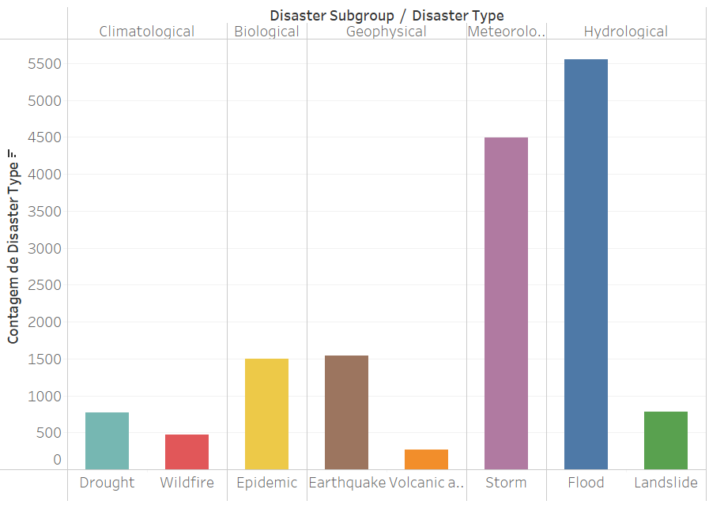
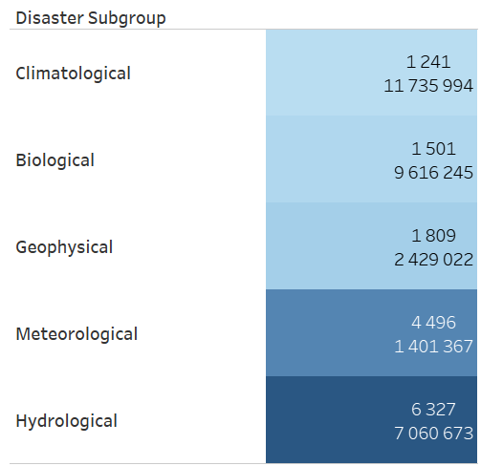
Natural Disasters
(1900-2021)
Count of Disaster Type

Slide 5
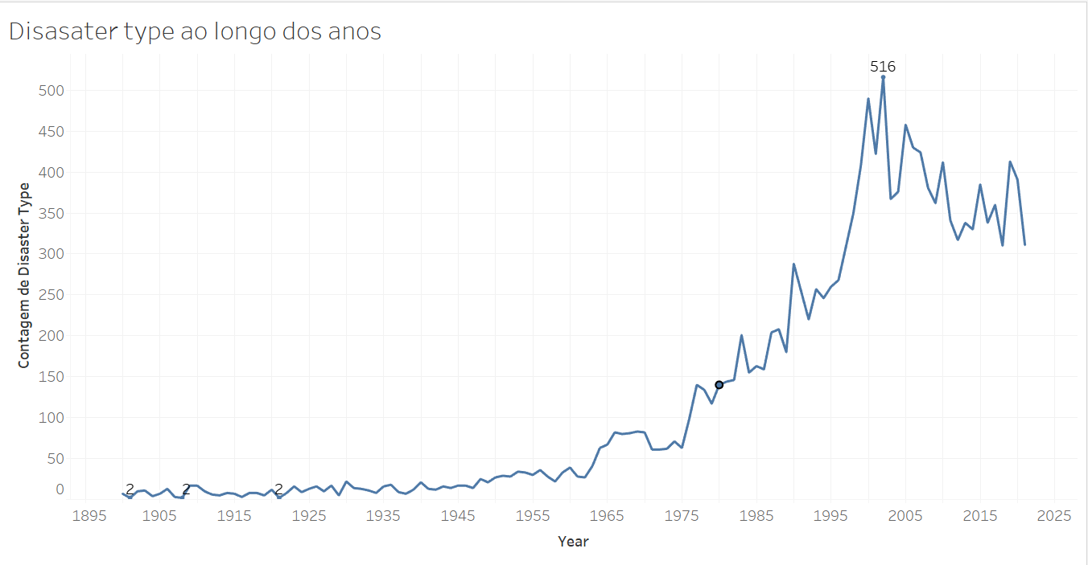
Disaster type over the years
Count of Disaster Type

Slide 6
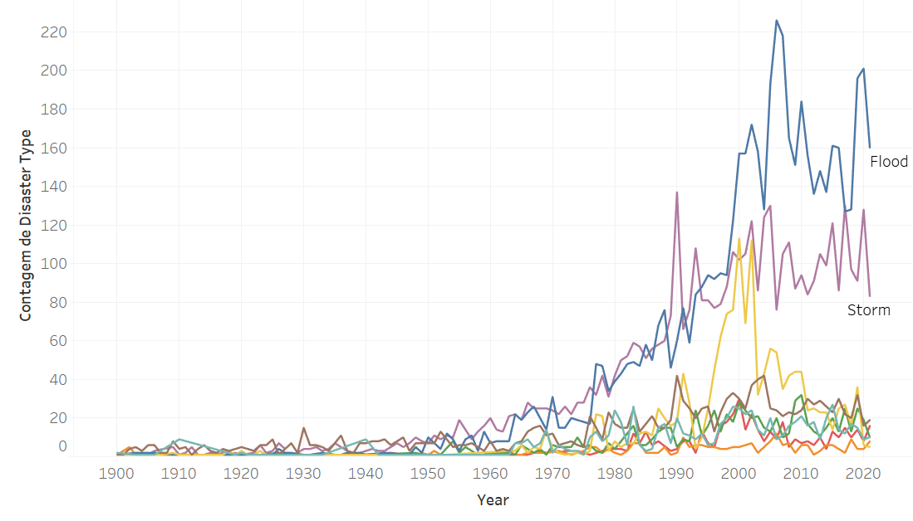
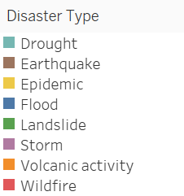
Disaster type over the years
Count of Disaster Type

Slide 7
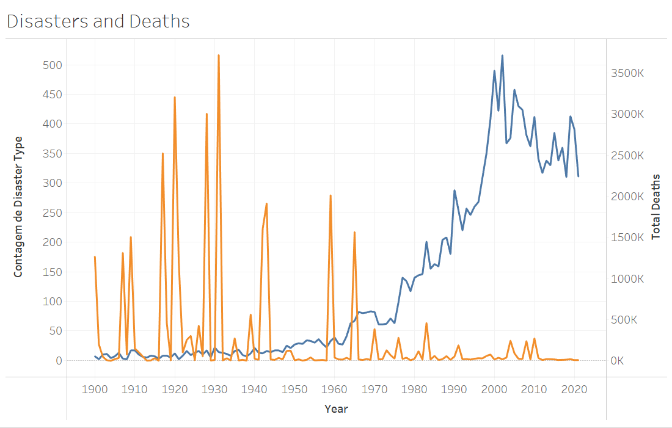

Total Deaths and Disaster Type
Count of Disaster Type

Slide 8





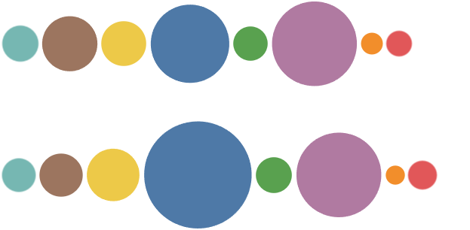
Disaster Type
Drought Earthquake Epidemic Flood Landslide Storm Volcanic Wildfire
412
957
633
1932
371
2239
150
208
358
587
868
3619
405
2257
115
263

Slide 9
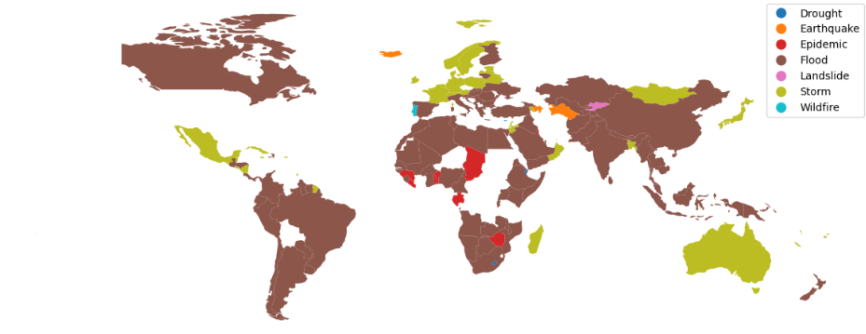
Disaster Type (2000-presente)

Slide 10
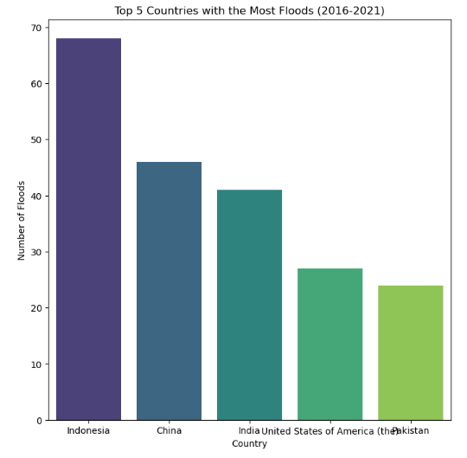
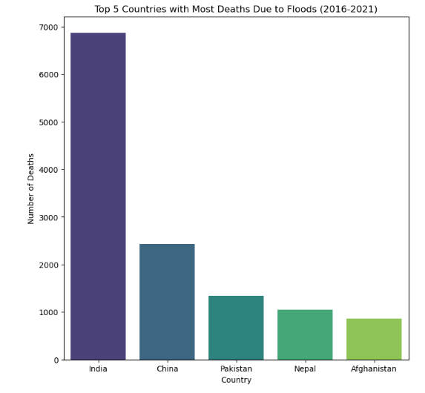
Disaster Type - Floods

Slide 11
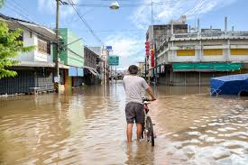
Contributing Factors
1. Population Density in Flood-Prone Areas
2. Infrastructure and Urban Planning
3. Warning Systems
4. Response Operations
5. Economic Factors
6. Terrain and Environmental Factors
7. Healthcare and Post-Disaster Support

Slide 12
Thank You!

